Slide 1
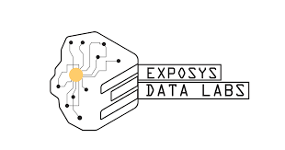
Diabetes Prediction
Model
By - Toshit Galande
College - Government College of Engineering Nagpur

Slide 2
Introduction
Diabetes is a disease that occurs when your blood glucose, also called blood sugar, is too high. It is a type of chronic disease is commonly among the group of the people. Making the model using machine learning algorithms that can predict the disease at early stage can save people lives.

Slide 3
Objective
Creating a model based on machine learning algorithms that can predict or diagnose the diabetic person.
Also make him\her aware and help to take precautions if the person found positive for diabetes disease.

Slide 4
Source, Tools & Technology
Source - - The dataset is taken from the kaggle website. The dataset consist of 9 columns and each contain 2000 rows. The dataset contain Pregnancies, Glucose, BloodPressure, Skin Thickness, Insulin, BMI, DiabetesPedigreeFunction, Age and Outcome columns.

Slide 5
Tools and Technology -
Python as the programming language is used.
Packages such as Numpy,Pandas, Matplotlib, Seaborn have been used.
Algorithms such logistic Regression, Random forest algorithms are used to gain accuracy of the model
Software such as jupyter notebook are used.

Slide 6
Conclusion
We have Implemented a model that can predict the diabetes in person with an accuracy of 93.3%. Thus it help people to take preventive measure if they found the diabetic disease in them and lead to their healthier lifestyle a new start.

Slide 7
Thank you
“ The first wealth is health. “

